Slide 1

This course was developed as a part of the VLIR-UOS Cross-Cutting project s:
Statistics: 2011-2012, 2013,2014-2015.
Statistics: 2016/2017.
Statistics for development : 2018-2020.

Slide 2




Linear regression in R
The >eR-Biostat initiative
Making R based education materials in statistics accessible for all
Slides developed by Ziv Shkedy (Hasselt University, Belgium, July 2017)
based on an online course developed by
Marc Lavielle
Inria Saclay (Xpop) & Ecole Polytechnique (CMAP)
March, 2017
LAST UPDATE: 15/10/2017
ER-BioStat
https://github.com/eR-Biostat
Email: erbiostat@gmail.com
@erbiostat

Slide 3
Contents
Fitting polynomial models
  Fitting a polynomial of degree 0
  Fitting a polynomial of degree 1
  Numerical results
  Some diagnostic plots
  The predictive performance of the model
  Confidence interval and prediction interval
  Fitting a polynomial of degree 2
  Fitting a polynomial without intercept
  Using orthogonal polynomials
Model comparison
  t-test
  Analysis-of-variance (anova)
  Likelihood ratio test (LRT)
  Information criteria
Data transformation
  log based tranformations
  Diagnostic plots
  Confidence interval and prediction interval
  Model comparison

Slide 4
YouTube tutorials
YouTube tutorials are available for:
  Linear regression in R (host by Christoph Scherber): https://www.youtube.com/watch?v=Xh6Rex3ARjc&t=838s
  Linear regression in R (host by Ani Katachova): https://www.youtube.com/watch?v=flnEw5LTvxM
  Simple Linear regression in R (host by Mike Marin): https://www.youtube.com/watch?v=66z_MRwtFJM&list=PLqzoL9-eJTNBJrvFcN-ohc5G13E7Big0e
  Checking Linear Regression Assumptions in R (host by Mike Marin): https://www.youtube.com/watch?v=eTZ4VUZHzxw

Slide 5
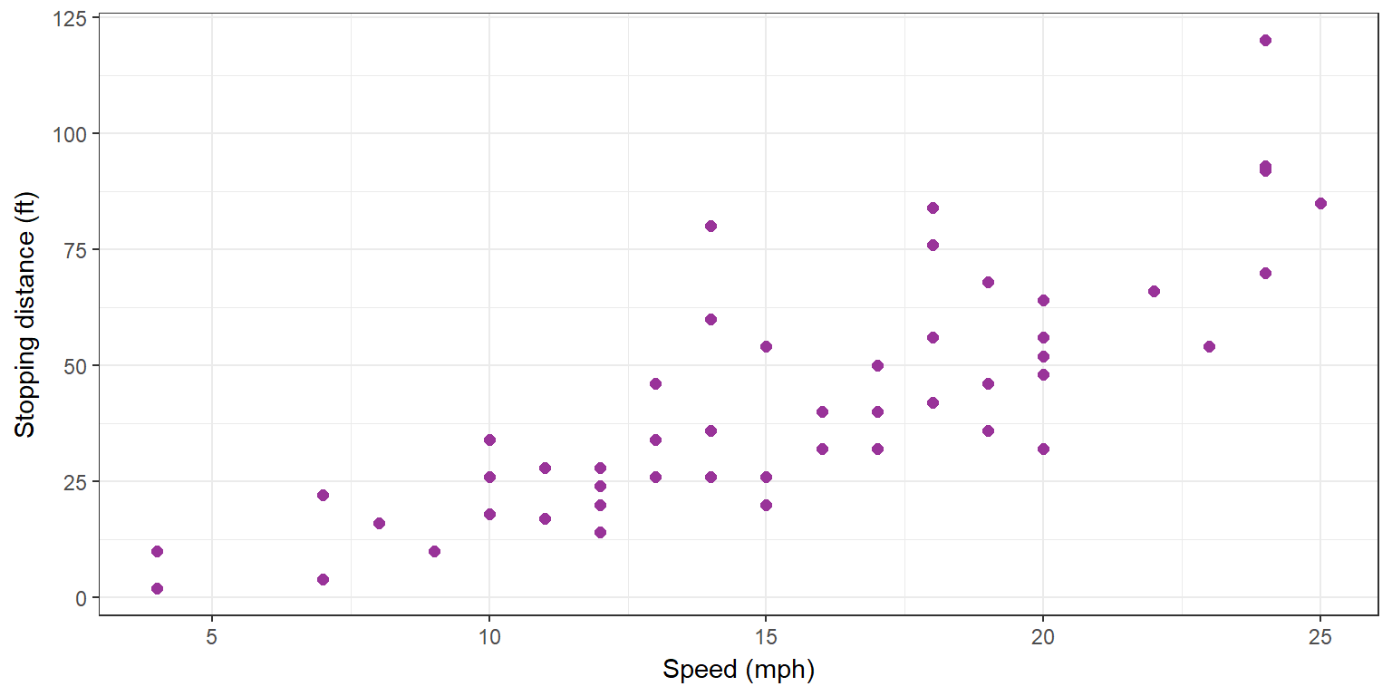
The Car data
Cars’ speed and stopping distance.
Cars form the 1920s
The data

Slide 6
Data Structure
The cars data in R
(X₁,Y₁)
(X₂,Y₂)
. .
. .
(X_{i},Y_{i})
. .
. .
(X_{n},Y_{n})
> data(cars)
> head(cars)
speed dist
1 4 2
2 4 10
3 7 4
4 7 22
5 8 16
6 9 10
Dependent variable:
Stopping distance y_{i}
Speed x_{i}
Speed x_{i}
Stopping Distance y_{i}

Slide 7
What is a Simple Linear Regression
Model ?
A regression model is a statistical model which aims to describe the relationship between a predictor (the dose level) and the dependent variable (test score) with a straight line.
Y
X

Slide 8
Properties of Simple Linear Regression Models : Trends
y
y
y
X
X
X
Upward trend
Downward trend
Y does not depend on X

Slide 9
Properties of Simple Linear Regression Models : Slope
y
X
The sploe is the change in the mean of Y for a unit change in X.
y
X

Slide 10
Properties of Simple Linear Regression Models : Intercept
y
y
y
X
0
X
X
The intercept is the highet of the regression line when x=0.
y
0
X

Slide 11
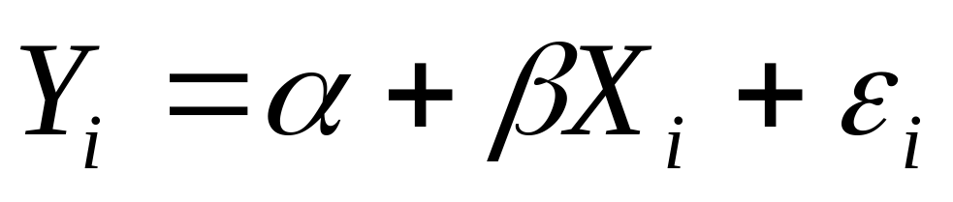
A Simple Linear Regression Model
We assume that the relationship between the predictor and
the response can be describe with the model:
Dependent variable Y_{i}
Predictor X_{i}
observed
Two parameters: intercept and slope
Random error
unobserved

Slide 12
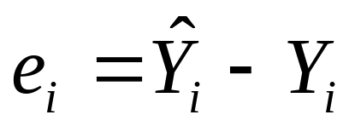
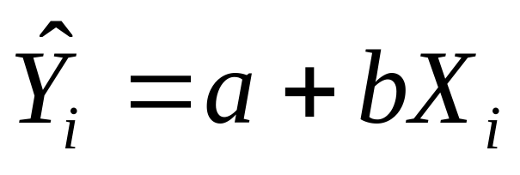
Estimation (I)
We need to estimate the unobserved parameters of the model:
The estimator for the random error:
predicted value for the test score
(the estimator for stopping distance)
a and b are the estimators for alpha and beta
e_{i} (the residual) is the estimator for the random error

Slide 13
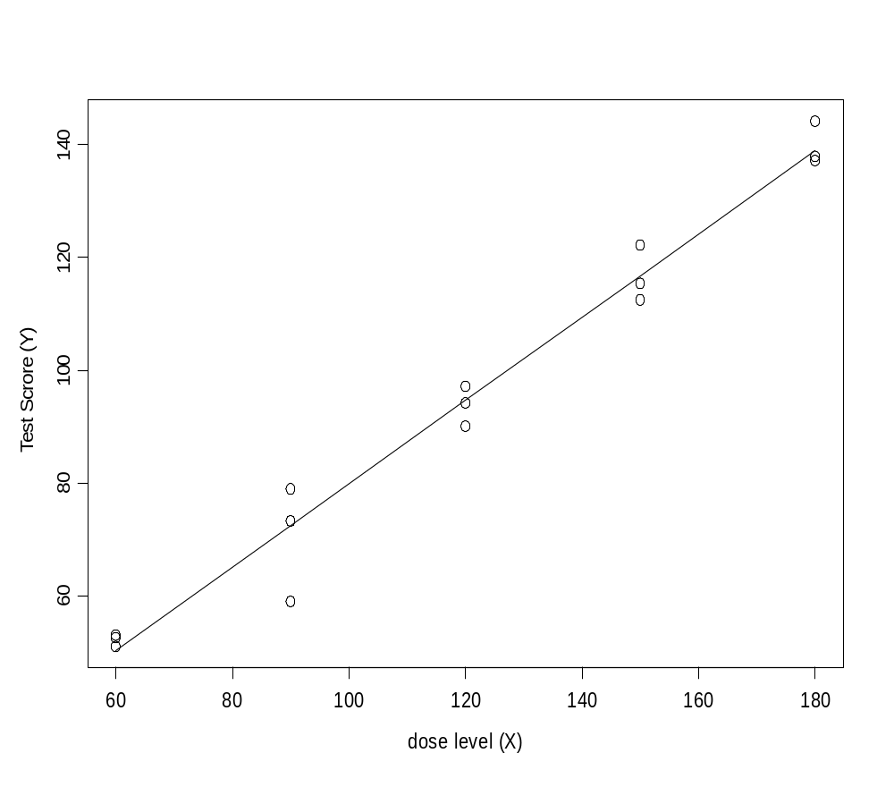
Regression Model and Data
a: the estimate for alpha
b: the estimate for beta
The estimated (fitted) model
The regression line
Y_{i}=12.06+0.69 X_{i}
The model

Slide 14
The Residuals
Y_{i}
X_{i}
e₁₁=(a+bX₁₁)-Y₁₁
residual
Y₄
e_{i}
X₄
X_{i}

Slide 15

Estimation (II): The Least Squares Criterion
How to estimate the intercept and slope?
We want that the fitted model (the line which describes the relationship between Y and X) will be “close” to the data.
The residual sum of squares = sum (residual)².
The least squares criterion: choose intercept and slope which minimize the residual sum of squares

Slide 16
contents
Fitting polynomial models
  Fitting a polynomial of degree 0
  Fitting a polynomial of degree 1
  Numerical results
  Some diagnostic plots
  The predictive performance of the model
  Confidence interval and prediction interval
  Fitting a polynomial of degree 2
  Fitting a polynomial without intercept
  Using orthogonal polynomials
Model comparison
  t-test
  Analysis-of-variance (anova)
  Likelihood ratio test (LRT)
  Information criteria
Data transformation
  log based tranformations
  Diagnostic plots
  Confidence interval and prediction interval
  Model comparison

Slide 17
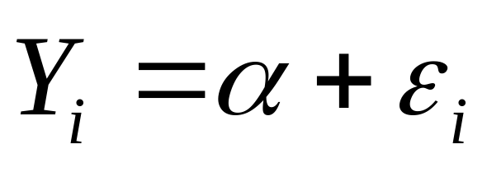
A Simple Linear Regression Model
We assume that the relationship between the predictor and
the response is constant and can be describe with the
model:
Dependent variable Y_{i}
observed
one parameter: intercept
Random error
unobserved

Slide 18
Polynomial of degree 0 in R
attach(cars)
lm0 <- lm(dist ~ 1)

Slide 19

R output for the estimated model
> summary(lm0)
Call:
lm(formula = dist ~ 1)
Residuals:
Min 1Q Median 3Q Max
-40.98 -16.98 -6.98 13.02 77.02
Coefficients:
Estimate Std. Error t value Pr(>|t|)
(Intercept) 42.980 3.644 11.79 6.38e-16 ***
---
Signif. codes: 0 ‘***’ 0.001 ‘**’ 0.01 ‘*’ 0.05 ‘.’ 0.1 ‘ ’ 1
Residual standard error: 25.77 on 49 degrees of freedom

Slide 20
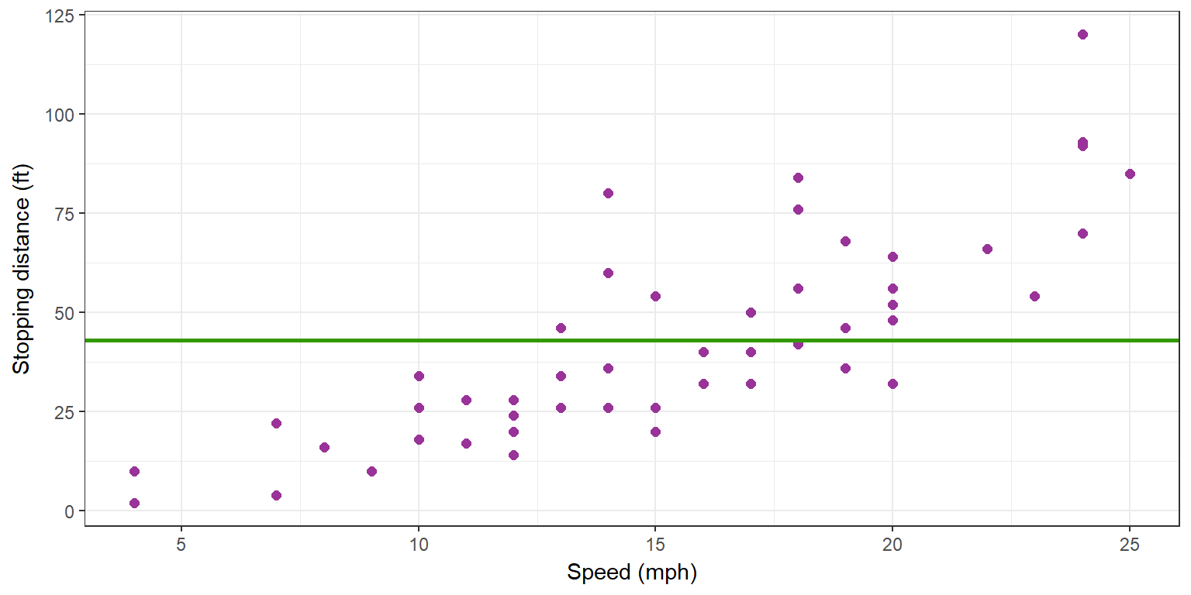

Data and estimated model

Slide 21
contents
Fitting polynomial models
  Fitting a polynomial of degree 0
  Fitting a polynomial of degree 1
  Numerical results
  Some diagnostic plots
  The predictive performance of the model
  Confidence interval and prediction interval
  Fitting a polynomial of degree 2
  Fitting a polynomial without intercept
  Using orthogonal polynomials
Model comparison
  t-test
  Analysis-of-variance (anova)
  Likelihood ratio test (LRT)
  Information criteria
Data transformation
  log based tranformations
  Diagnostic plots
  Confidence interval and prediction interval
  Model comparison

Slide 22
A Simple Linear Regression Model
We assume that the relationship between the predictor and
the response can be describe with the model:
Dependent variable Y_{i}
Predictor X_{i}
observed
Two parameters: intercept and slope
Random error
unobserved

Slide 23

A simple linear regression in R
lm1 <- lm(dist ~ speed, data=cars)
coef(lm1)
## (Intercept) speed
## -17.579095 3.932409

Slide 24
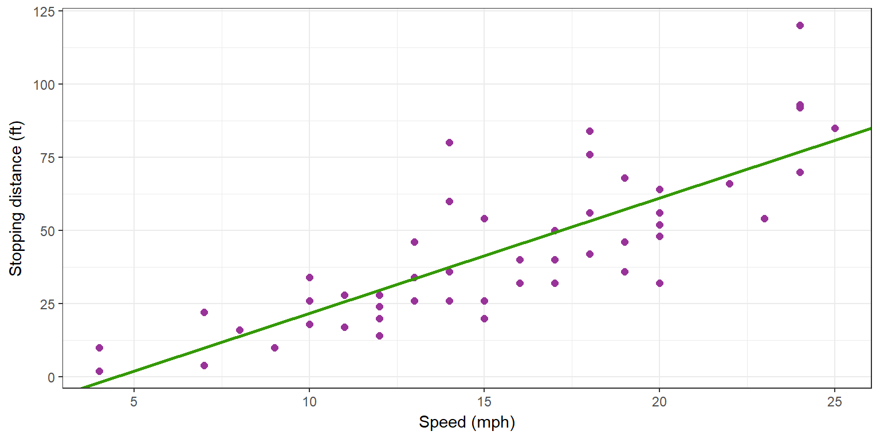
Data and estimated model

Slide 25
Estimated model in R
> summary(lm1)
Call:
lm(formula = dist ~ speed, data = cars)
Residuals:
Min 1Q Median 3Q Max
-29.069 -9.525 -2.272 9.215 43.201
Coefficients:
Estimate Std. Error t value Pr(>|t|)
(Intercept) -17.5791 6.7584 -2.601 0.0123 *
speed 3.9324 0.4155 9.464 1.49e-12 ***
---
Signif. codes: 0 ‘***’ 0.001 ‘**’ 0.01 ‘*’ 0.05 ‘.’ 0.1 ‘ ’ 1
Residual standard error: 15.38 on 48 degrees of freedom
Multiple R-squared: 0.6511, Adjusted R-squared: 0.6438
F-statistic: 89.57 on 1 and 48 DF, p-value: 1.49e-12

Slide 26
Confidence interval for the parameters
> confint(lm1)
2.5 % 97.5 %
(Intercept) -31.167850 -3.990340
speed 3.096964 4.767853

Slide 27
Summary

Slide 28



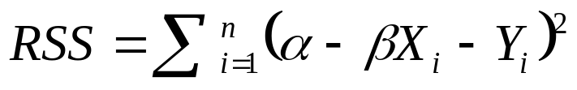
Technical Details (Estimation)
A simple linear regression model has the form:
and are the parameters in the model and is the random error.
We can estimate and by minimizing the residual sum of squares

Slide 29
Technical Details (Estimation)
The estimated model
The residual

Slide 30




Technical Details (Estimation)
We assume that the relationship between Y_{i} and X_{i} can be described with a statistical model
We assume that the random error is normally distributed.
The mean of is equal to zero
The conditional mean of Y_{i} (given the value of X_{i})
The estimator for the conditional mean of Y_{i} (the fitted model=the regression line)
The residual: the estimator for
Least square criterion: choose a and b that minimize the residuals sum of squares

Slide 31
contents
Fitting polynomial models
  Fitting a polynomial of degree 0
  Fitting a polynomial of degree 1
  Numerical results
  Some diagnostic plots
  The predictive performance of the model
  Confidence interval and prediction interval
  Fitting a polynomial of degree 2
  Fitting a polynomial without intercept
  Using orthogonal polynomials
Model comparison
  t-test
  Analysis-of-variance (anova)
  Likelihood ratio test (LRT)
  Information criteria
Data transformation
  log based tranformations
  Diagnostic plots
  Confidence interval and prediction interval
  Model comparison

Slide 32

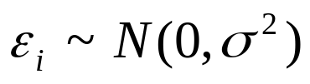
Simple regression model and it’s assumtions
We focus on model diagnostic. We consider the following linear regression model
The random error is assumed to be normal distributed:
We also assume that the variance is constant, i.e., the variavce of ε₁,ε₂,....,ε_{n} is equal.

Slide 33
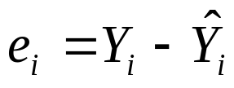
How to check the model assumptions? (1)
The random error, ε_{i}, is unknown but we can estimate ε_{i} with the residuals
The residuals can be used in order to check the model asaumptions.
We focus on two things:
1) the distribution of e_{i}
2) the variability of e_{i}
Observed
Predicted

Slide 34
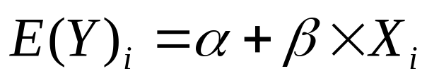
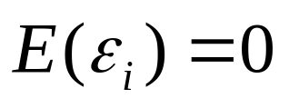
How to check the model assumptions? (2)
We assume that the mean of Y_{i} is linear with respect to X:
This is true only if
Once again, the residuals can be used in order to check the linearity asaumption .
The residuals in this plot should be around zero and do not show any systematic pattern.
residuals
0
predictor

Slide 35
Assumption 1: The distribution of e_{i}
The distribution of e_{i} is expected to be normal with mean zero and variance σ²
qq-normal plot (or normal probability plot) is a graphical tool that can be used in order to asses the normality assumption.
If the normalty assumption holds we expect qq-normal plot will be a srtight line.

Slide 36
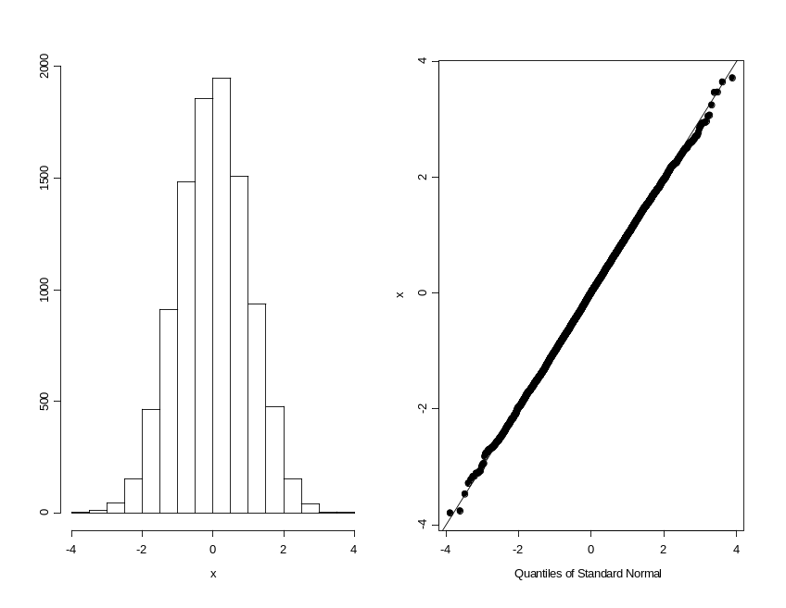
Example of qqnormal plot form N(0,1)
Sample of 10000 observations from N(0,1)
The qqnormal plot is a stright line.
If the random error ε_{i} is normal distributed, the qqnormal plot of the residuals should be a stright line.

Slide 37
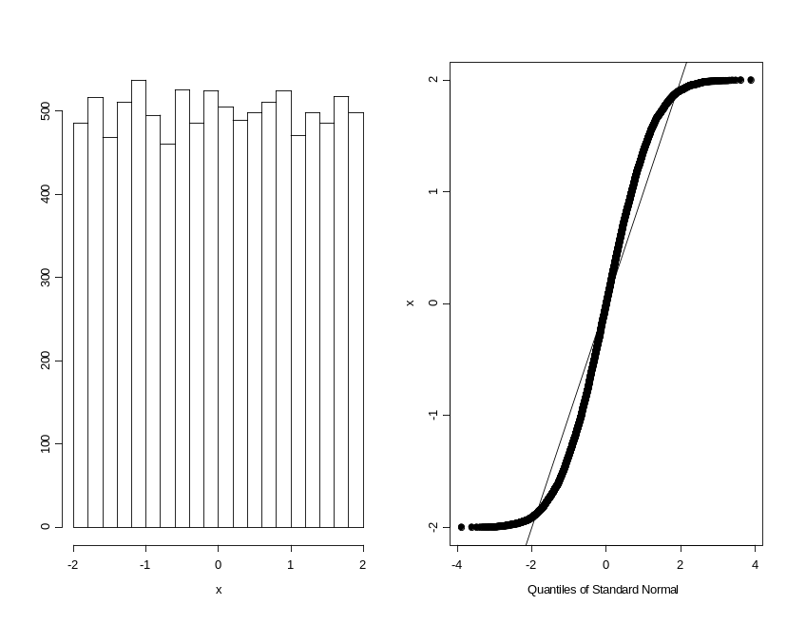
Example of qqnormal polt from havy tailed distribution
Sample of 10000 observations from
U(-2,2).
S shape of the qqnormal plot.
This is an example of a symatric distribution with more observations (relativly to the normal distribution) at the tails.

Slide 38
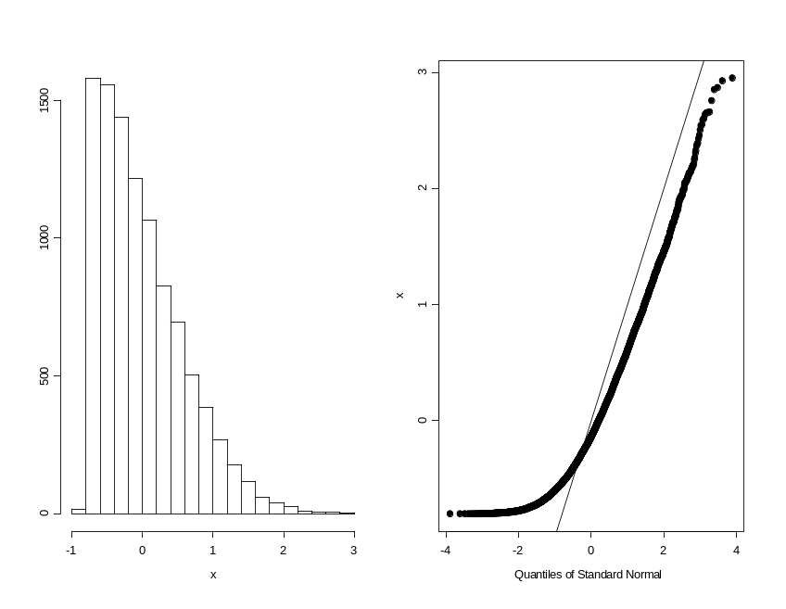
Example of qqnormal polt from skwed distribution
Sample of 10000 observations from a skewed distribution.
The distribution is sewed to the right and the points in the qqplot are not follow the stright line.

Slide 39
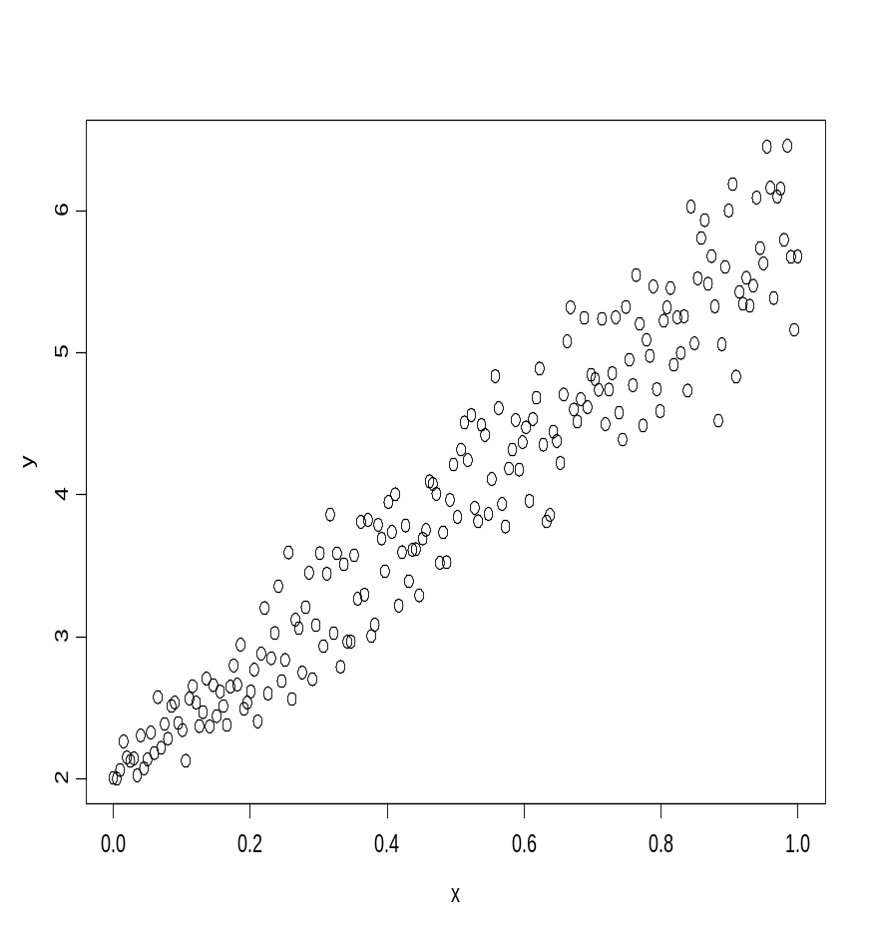
Assumption 2: Constant variance
This is an example of a dataset in which the variance is not constant.
The variance increases when the value of X increases.
However, there is a linear relatioship between the predictor and the response.

Slide 40
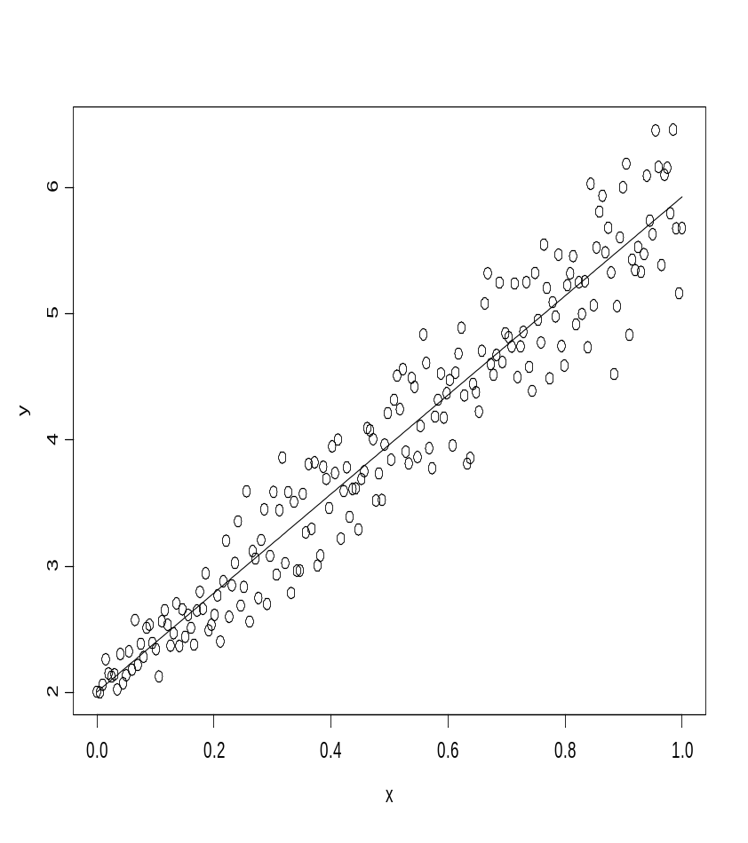
The data and the resrssion line
The model seems to fit the data well in the sense that is captures that structure of the mean.

Slide 41
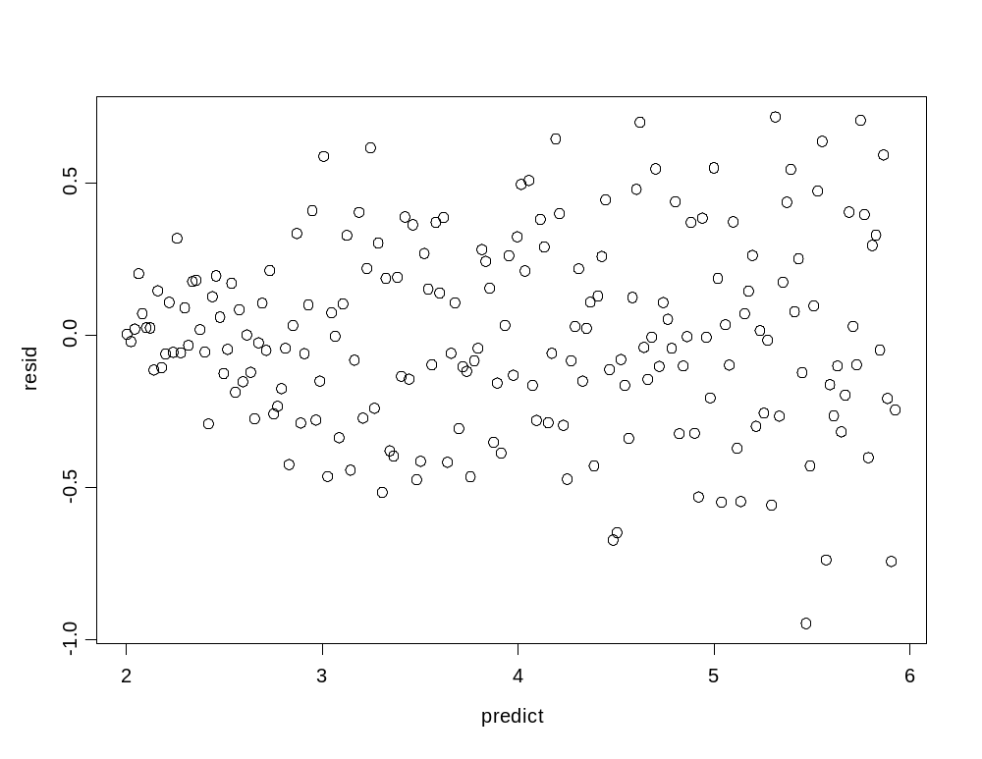
Residuals plot: Residuals versus the predicted values
In this plot we can see clearly a pattern. As the predicted values increase the variability among the residuals increase (a “megaphone” shape).

Slide 42
Assumptio 3: Linearity
The data
e versus x
y
e
Example of systematic pattern in the residual plot.
0
X
X
The scatterplot of the data reveals that the association between the response and the predictor is not linear. The residuals plot (in the right) reveals a clear pattern among the residuals which depends on the value of X.

Slide 43
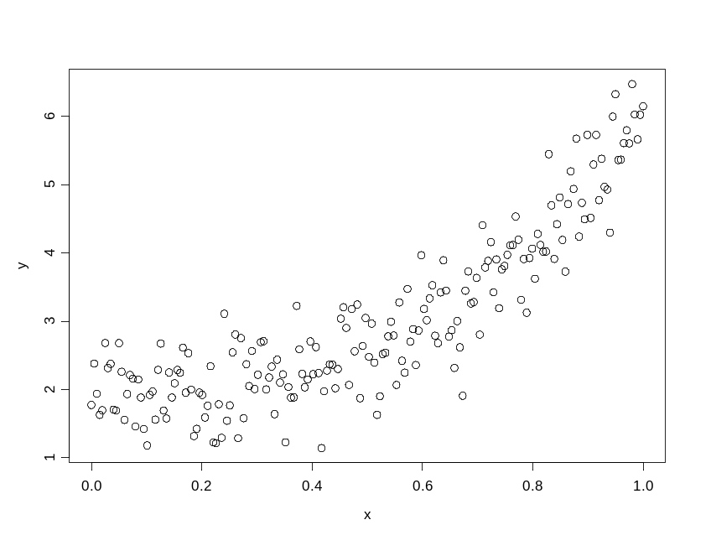
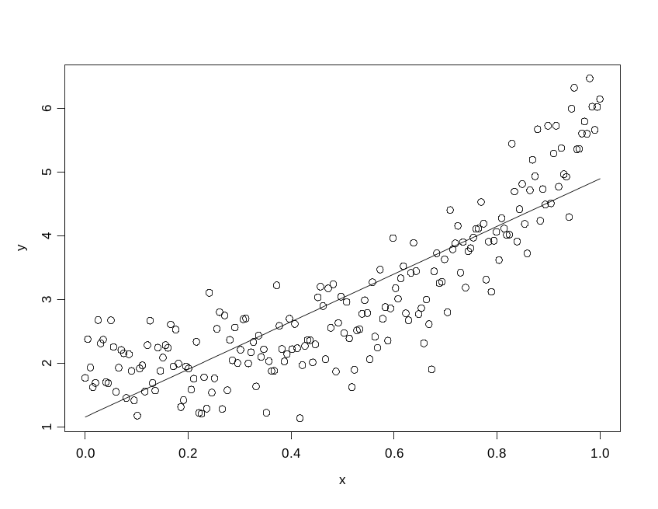
Systematic patterns
data
data and fitted model
The model underestimates the value of Y when the value of X is relatively small or large.

Slide 44
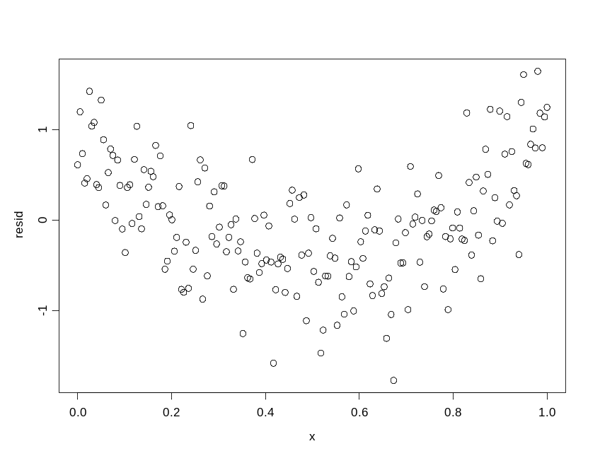
Linearity: Residuals plot
This plot reveals clear systematic pattern among the residuals: the residuals are positive for small and large value of X and negative in the middle. This means that there is structure in the data that the linear regression model did not capture.

Slide 45
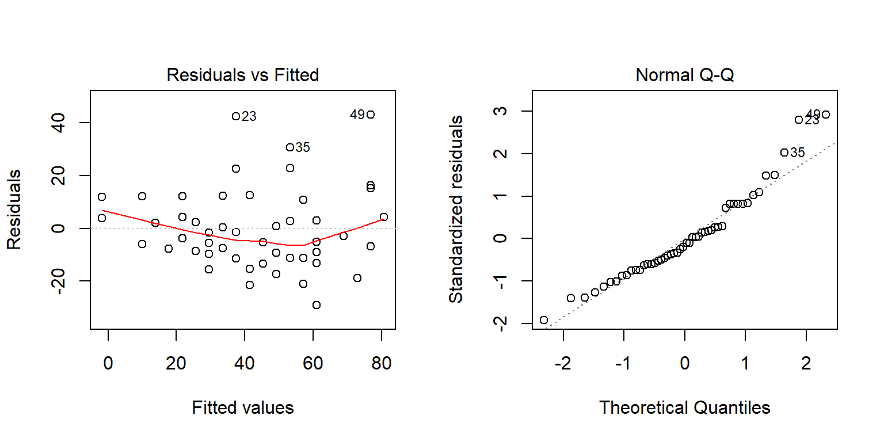
Diagnostic plots in R
lm1 <- lm(dist ~ speed, data=cars)
par(mfrow = c(1, 2))
plot(lm1, which=c(1,2))

Slide 46
contents
Fitting polynomial models
  Fitting a polynomial of degree 0
  Fitting a polynomial of degree 1
  Numerical results
  Some diagnostic plots
  The predictive performance of the model
  Confidence interval and prediction interval
  Fitting a polynomial of degree 2
  Fitting a polynomial without intercept
  Using orthogonal polynomials
Model comparison
  t-test
  Analysis-of-variance (anova)
  Likelihood ratio test (LRT)
  Information criteria
Data transformation
  log based tranformations
  Diagnostic plots
  Confidence interval and prediction interval
  Model comparison

Slide 47
Cross-validation for prediction
A common practice is to split the dataset into a 80:20 sample (training:test), then, build the model on the 80% sample and then use the model thus built to predict the reponse variable on test data.

Slide 48
Predicted values for the test data
> set.seed(100)
> n <- nrow(cars)
> i.training <- sort(sample(n,round(n*0.8)))
> cars.training <- cars[i.training,]
> cars.test <- cars[-i.training,]
> pred1a.test <- predict(lm1, newdata=cars.test)
>
>
> lm1.training <- lm(dist ~ speed, data=cars.training)
> pred1b.test <- predict(lm1.training, newdata=cars.test)
> data.frame(cars.test, pred1a.test, pred1b.test)
speed dist pred1a.test pred1b.test
1 4 2 -1.849460 -5.392776
4 7 22 9.947766 7.555787
8 10 26 21.744993 20.504349
20 14 26 37.474628 37.769100
26 15 54 41.407036 42.085287
31 17 50 49.271854 50.717663
37 19 46 57.136672 59.350038
39 20 32 61.069080 63.666225
40 20 48 61.069080 63.666225
42 20 56 61.069080 63.666225

Slide 49
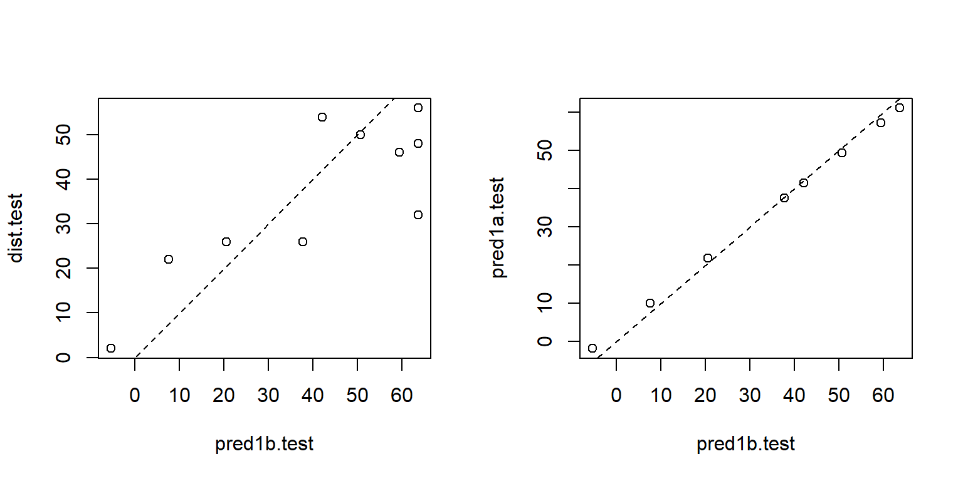
Predicted values for two test dataset and the observed data

Slide 50
contents
Fitting polynomial models
  Fitting a polynomial of degree 0
  Fitting a polynomial of degree 1
  Numerical results
  Some diagnostic plots
  The predictive performance of the model
  Confidence interval and prediction interval
  Fitting a polynomial of degree 2
  Fitting a polynomial without intercept
  Using orthogonal polynomials
Model comparison
  t-test
  Analysis-of-variance (anova)
  Likelihood ratio test (LRT)
  Information criteria
Data transformation
  log based tranformations
  Diagnostic plots
  Confidence interval and prediction interval
  Model comparison

Slide 51
Confidence intervals for regression line
> alpha <- 0.05
> df.new <- data.frame(speed=(6:23))
> conf.dist <- predict(lm1, newdata = df.new, interval="confidence",
level=1-alpha)
> head(conf.dist)
fit lwr upr
1 6.015358 -2.973341 15.00406
2 9.947766 1.678977 18.21656
3 13.880175 6.307527 21.45282
4 17.812584 10.905120 24.72005
5 21.744993 15.461917 28.02807
6 25.677401 19.964525 31.39028

Slide 52
A prediction interval for a new measured distance
> pred.dist <- predict(lm1, newdata = df.new, interval="prediction",
level=1-alpha)
> head(pred.dist)
fit lwr upr
1 6.015358 -26.187314 38.21803
2 9.947766 -22.061423 41.95696
3 13.880175 -17.956287 45.71664
4 17.812584 -13.872245 49.49741
5 21.744993 -9.809601 53.29959
6 25.677401 -5.768620 57.12342

Slide 53
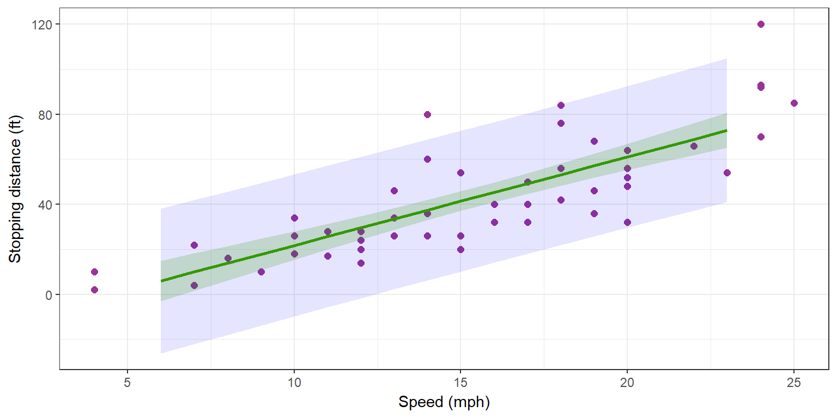
Graphical display for the two confidence intervals

Slide 54
contents
Fitting polynomial models
  Fitting a polynomial of degree 0
  Fitting a polynomial of degree 1
  Numerical results
  Some diagnostic plots
  The predictive performance of the model
  Confidence interval and prediction interval
  Fitting a polynomial of degree 2
  Fitting a polynomial without intercept
  Using orthogonal polynomials
Model comparison
  t-test
  Analysis-of-variance (anova)
  Likelihood ratio test (LRT)
  Information criteria
Data transformation
  log based tranformations
  Diagnostic plots
  Confidence interval and prediction interval
  Model comparison

Slide 55
Polynomial of degree 2
> lm2 <- lm(dist ~ speed + I(speed^2))
> summary(lm2)
Call:
lm(formula = dist ~ speed + I(speed^2))
Residuals:
Min 1Q Median 3Q Max
-28.720 -9.184 -3.188 4.628 45.152
Coefficients:
Estimate Std. Error t value Pr(>|t|)
(Intercept) 2.47014 14.81716 0.167 0.868
speed 0.91329 2.03422 0.449 0.656
I(speed^2) 0.09996 0.06597 1.515 0.136
Residual standard error: 15.18 on 47 degrees of freedom
Multiple R-squared: 0.6673, Adjusted R-squared: 0.6532
F-statistic: 47.14 on 2 and 47 DF, p-value: 5.852e-12

Slide 56
Covariance matrix of the vector of estimates
> X <- model.matrix(lm2)
> S <- solve(t(X)%*%X)
> d <- sqrt(diag(S))
> R <- S/(d%*%t(d))
> R
(Intercept) speed I(speed^2)
(Intercept) 1.0000000 -0.9605503 0.8929849
speed -0.9605503 1.0000000 -0.9794765
I(speed^2) 0.8929849 -0.9794765 1.0000000

Slide 57
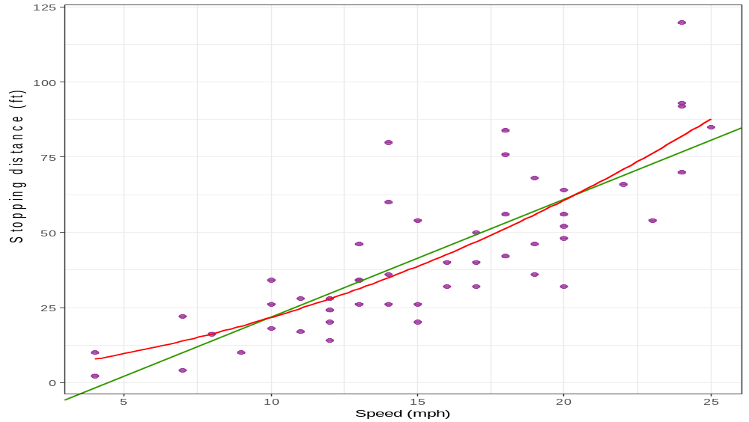
Data and estimated model

Slide 58
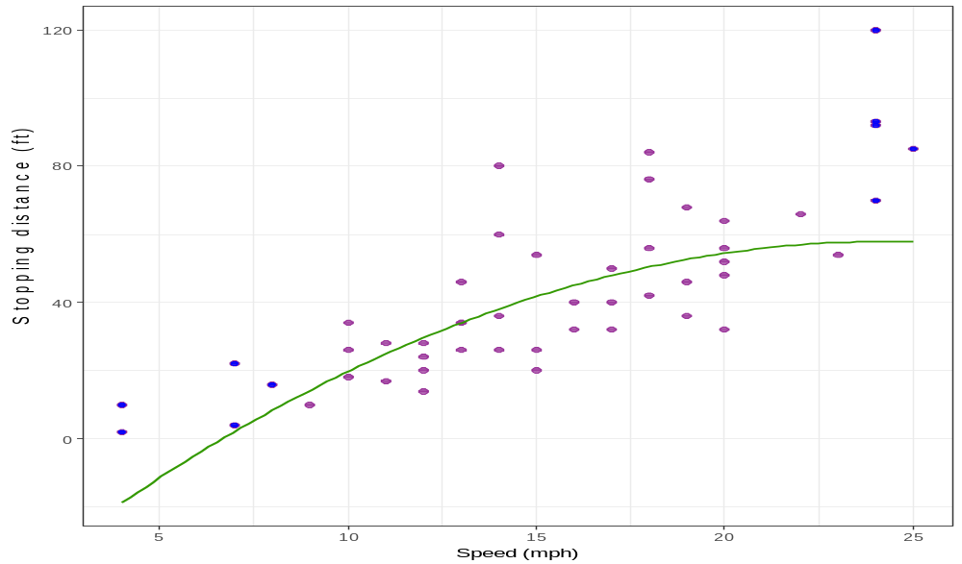
Predicted model with the 80% most central data points

Slide 59
contents
Fitting polynomial models
  Fitting a polynomial of degree 0
  Fitting a polynomial of degree 1
  Numerical results
  Some diagnostic plots
  The predictive performance of the model
  Confidence interval and prediction interval
  Fitting a polynomial of degree 2
  Fitting a polynomial without intercept
  Using orthogonal polynomials
Model comparison
  t-test
  Analysis-of-variance (anova)
  Likelihood ratio test (LRT)
  Information criteria
Data transformation
  log based tranformations
  Diagnostic plots
  Confidence interval and prediction interval
  Model comparison

Slide 60
Fitting a polynomial without intercept
> lm2.noint <- lm(dist ~ -1 + speed + I(speed^2))
> coef(lm2.noint)
speed I(speed^2)
1.23902996 0.09013877
> X <- model.matrix(lm2.noint)
> head(X)
speed I(speed^2)
1 4 16
2 4 16
3 7 49
4 7 49
5 8 64
6 9 81
Design matrix

Slide 61
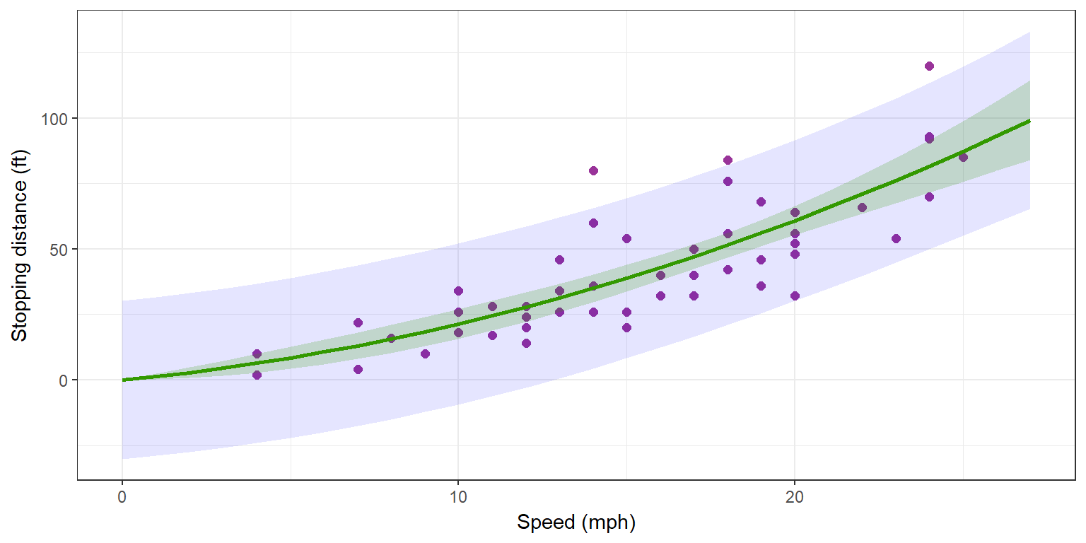
Data, predicted model, prediction intervals and confidence intervals

Slide 62
contents
Fitting polynomial models
  Fitting a polynomial of degree 0
  Fitting a polynomial of degree 1
  Numerical results
  Some diagnostic plots
  The predictive performance of the model
  Confidence interval and prediction interval
  Fitting a polynomial of degree 2
  Fitting a polynomial without intercept
  Using orthogonal polynomials
Model comparison
  t-test
  Analysis-of-variance (anova)
  Likelihood ratio test (LRT)
  Information criteria
Data transformation
  log based tranformations
  Diagnostic plots
  Confidence interval and prediction interval
  Model comparison

Slide 63
Orthogonal polynomials
> lm2.poly <- lm(dist ~ poly(speed, degree=2, raw=T))
> M <- model.matrix(lm2.poly)
> head(M)
(Intercept) poly(speed, degree = 2, raw = T)1
1 1 4
2 1 4
3 1 7
4 1 7
5 1 8
6 1 9
poly(speed, degree = 2, raw = T)2
1 16
2 16
3 49
4 49
5 64
6 81
Design matrix

Slide 64
contents
Fitting polynomial models
  Fitting a polynomial of degree 0
  Fitting a polynomial of degree 1
  Numerical results
  Some diagnostic plots
  The predictive performance of the model
  Confidence interval and prediction interval
  Fitting a polynomial of degree 2
  Fitting a polynomial without intercept
  Using orthogonal polynomials
Model comparison
  t-test
  Analysis-of-variance (anova)
  Likelihood ratio test (LRT)
  Information criteria
Data transformation
  log based tranformations
  Diagnostic plots
  Confidence interval and prediction interval
  Model comparison

Slide 65
T-test
> summary(lm1.ortho)$coefficients
Estimate Std. Error t value Pr(>|t|)
(Intercept) 42.9800 2.175002 19.76090 1.061332e-24
poly(speed, degree = 1) 145.5523 15.379587 9.46399 1.489836e-12

Slide 66
contents
Fitting polynomial models
  Fitting a polynomial of degree 0
  Fitting a polynomial of degree 1
  Numerical results
  Some diagnostic plots
  The predictive performance of the model
  Confidence interval and prediction interval
  Fitting a polynomial of degree 2
  Fitting a polynomial without intercept
  Using orthogonal polynomials
Model comparison
  t-test
  Analysis-of-variance (anova)
  Likelihood ratio test (LRT)
  Information criteria
Data transformation
  log based tranformations
  Diagnostic plots
  Confidence interval and prediction interval
  Model comparison

Slide 67

anova(model1,model2)
> anova(lm0, lm1)
Analysis of Variance Table
Model 1: dist ~ 1
Model 2: dist ~ speed
Res.Df RSS Df Sum of Sq F Pr(>F)
1 49 32539
2 48 11354 1 21186 89.567 1.49e-12 ***
---
Signif. codes: 0 ‘***’ 0.001 ‘**’ 0.01 ‘*’ 0.05 ‘.’ 0.1 ‘ ’ 1

Slide 68
anova(model1,model2)
> anova(lm1, lm2)
Analysis of Variance Table
Model 1: dist ~ speed
Model 2: dist ~ speed + I(speed^2)
Res.Df RSS Df Sum of Sq F Pr(>F)
1 48 11354
2 47 10825 1 528.81 2.296 0.1364

Slide 69
contents
Fitting polynomial models
  Fitting a polynomial of degree 0
  Fitting a polynomial of degree 1
  Numerical results
  Some diagnostic plots
  The predictive performance of the model
  Confidence interval and prediction interval
  Fitting a polynomial of degree 2
  Fitting a polynomial without intercept
  Using orthogonal polynomials
Model comparison
  t-test
  Analysis-of-variance (anova)
  Likelihood ratio test (LRT)
  Information criteria
Data transformation
  log based tranformations
  Diagnostic plots
  Confidence interval and prediction interval
  Model comparison

Slide 70
Likelihood ratio test (LRT)
> logLik(lm0)
'log Lik.' -232.9012 (df=2)
> logLik(lm1)
'log Lik.' -206.5784 (df=3)
> logLik(lm2)
'log Lik.' -205.386 (df=4)
>
> dl <- 2*as.numeric(logLik(lm1) - logLik(lm0))
> 1-pchisq(dl,1)
[1] 3.995693e-13
>
> dl <- 2*as.numeric(logLik(lm2) - logLik(lm1))
> 1-pchisq(dl,1)
[1] 0.122521
Model 0 versus model 1
Model 1 versus model 2

Slide 71
contents
Fitting polynomial models
  Fitting a polynomial of degree 0
  Fitting a polynomial of degree 1
  Numerical results
  Some diagnostic plots
  The predictive performance of the model
  Confidence interval and prediction interval
  Fitting a polynomial of degree 2
  Fitting a polynomial without intercept
  Using orthogonal polynomials
Model comparison
  t-test
  Analysis-of-variance (anova)
  Likelihood ratio test (LRT)
  Information criteria
Data transformation
  log based tranformations
  Diagnostic plots
  Confidence interval and prediction interval
  Model comparison

Slide 72
Information criteria
> AIC(lm0,lm1,lm2)
df AIC
lm0 2 469.8024
lm1 3 419.1569
lm2 4 418.7721
> BIC(lm0,lm1,lm2)
df BIC
lm0 2 473.6265
lm1 3 424.8929
lm2 4 426.4202

Slide 73
contents
Fitting polynomial models
  Fitting a polynomial of degree 0
  Fitting a polynomial of degree 1
  Numerical results
  Some diagnostic plots
  The predictive performance of the model
  Confidence interval and prediction interval
  Fitting a polynomial of degree 2
  Fitting a polynomial without intercept
  Using orthogonal polynomials
Model comparison
  t-test
  Analysis-of-variance (anova)
  Likelihood ratio test (LRT)
  Information criteria
Data transformation
  log based tranformations
  Diagnostic plots
  Confidence interval and prediction interval
  Model comparison

Slide 74
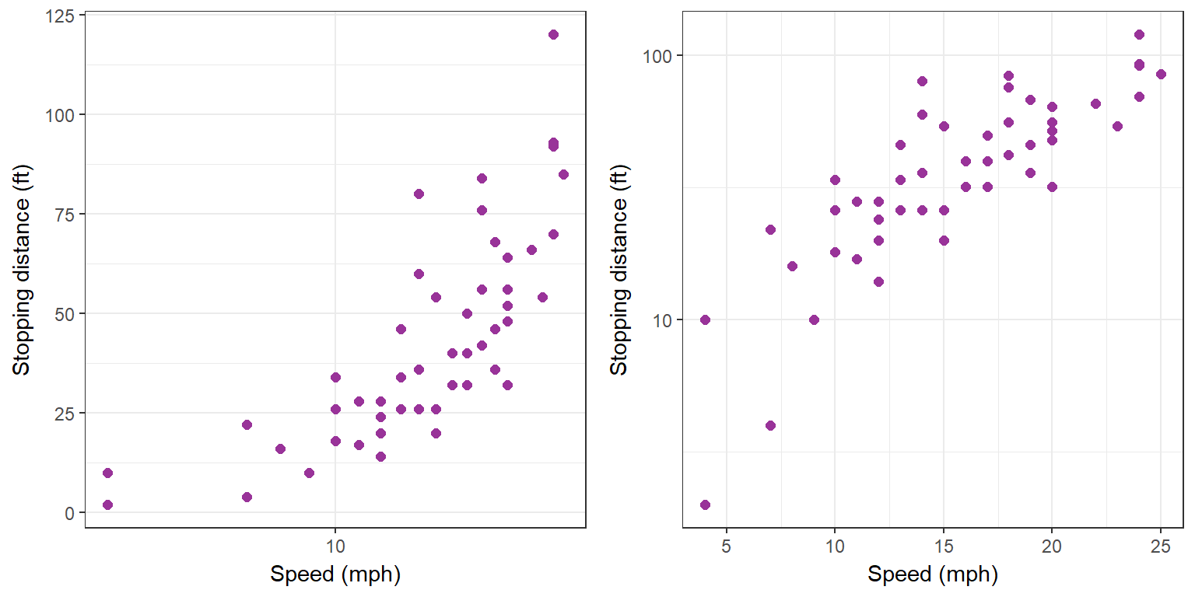
Logarithmic scale
logarithmic scale for the x-axis
logarithmic scale for the y-axis

Slide 75
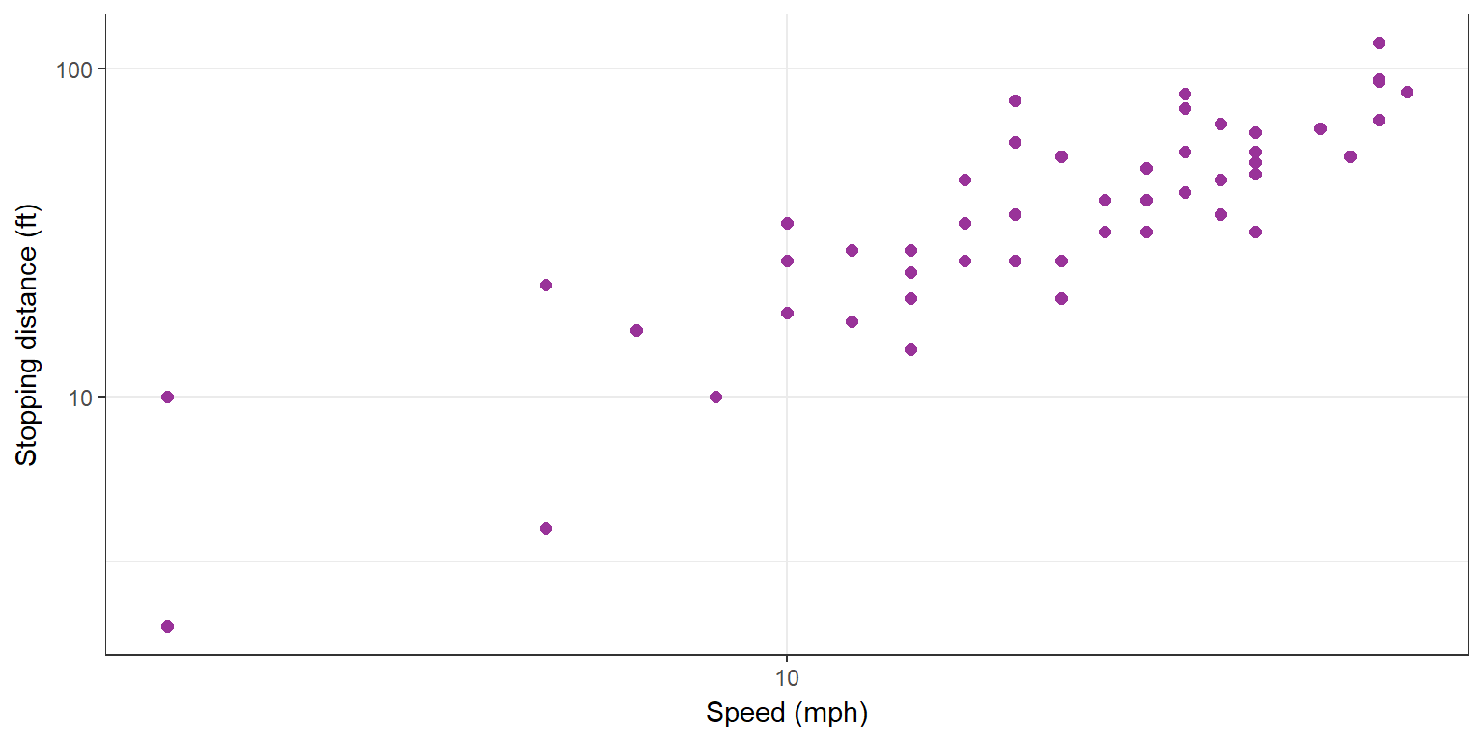
The data using log-log transformation.
log(dist)
log(speed)

Slide 76

Regression model for log(dist) and log(speed)
> lm1.log <- lm(log(dist) ~ log(speed))
> summary(lm1.log)
Call:
lm(formula = log(dist) ~ log(speed))
Residuals:
Min 1Q Median 3Q Max
-1.00215 -0.24578 -0.02898 0.20717 0.88289
Coefficients:
Estimate Std. Error t value Pr(>|t|)
(Intercept) -0.7297 0.3758 -1.941 0.0581 .
log(speed) 1.6024 0.1395 11.484 2.26e-15 ***
---
Signif. codes: 0 ‘***’ 0.001 ‘**’ 0.01 ‘*’ 0.05 ‘.’ 0.1 ‘ ’ 1
Residual standard error: 0.4053 on 48 degrees of freedom
Multiple R-squared: 0.7331, Adjusted R-squared: 0.7276
F-statistic: 131.9 on 1 and 48 DF, p-value: 2.259e-15

Slide 77
contents
Fitting polynomial models
  Fitting a polynomial of degree 0
  Fitting a polynomial of degree 1
  Numerical results
  Some diagnostic plots
  The predictive performance of the model
  Confidence interval and prediction interval
  Fitting a polynomial of degree 2
  Fitting a polynomial without intercept
  Using orthogonal polynomials
Model comparison
  t-test
  Analysis-of-variance (anova)
  Likelihood ratio test (LRT)
  Information criteria
Data transformation
  log based tranformations
  Diagnostic plots
  Confidence interval and prediction interval
  Model comparison

Slide 78
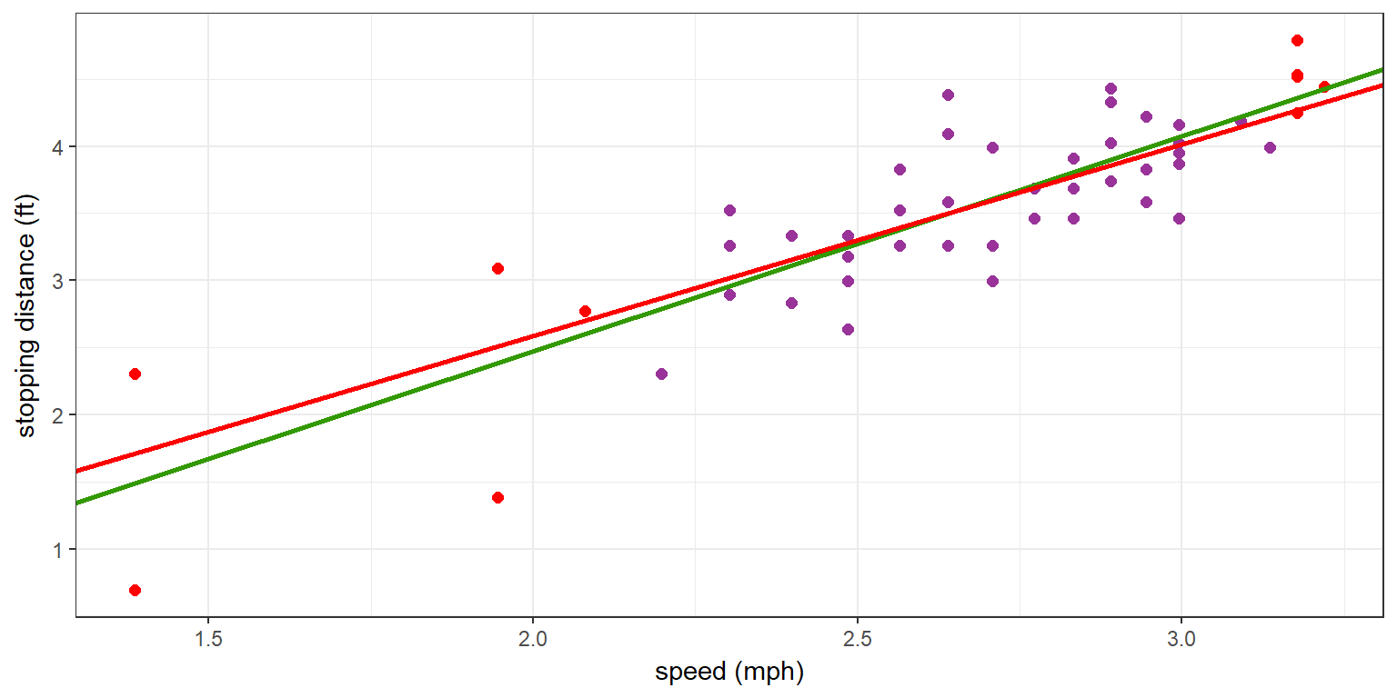
Data and estimated models
A model fitted using the complete data (green) and a model fitted when only the training sample is used (red).

Slide 79
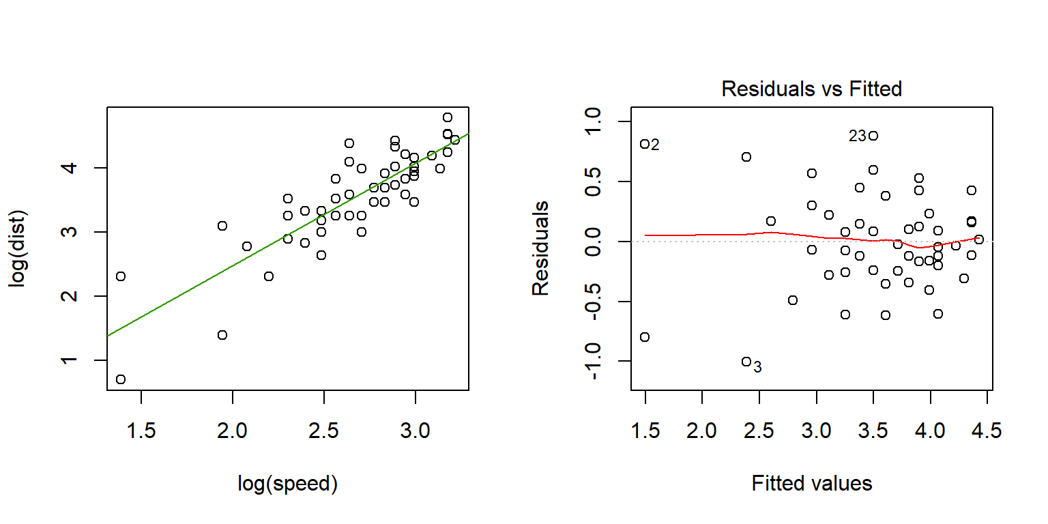
Diagnostic plots

Slide 80
contents
Fitting polynomial models
  Fitting a polynomial of degree 0
  Fitting a polynomial of degree 1
  Numerical results
  Some diagnostic plots
  The predictive performance of the model
  Confidence interval and prediction interval
  Fitting a polynomial of degree 2
  Fitting a polynomial without intercept
  Using orthogonal polynomials
Model comparison
  t-test
  Analysis-of-variance (anova)
  Likelihood ratio test (LRT)
  Information criteria
Data transformation
  log based tranformations
  Diagnostic plots
  Confidence interval and prediction interval
  Model comparison

Slide 81
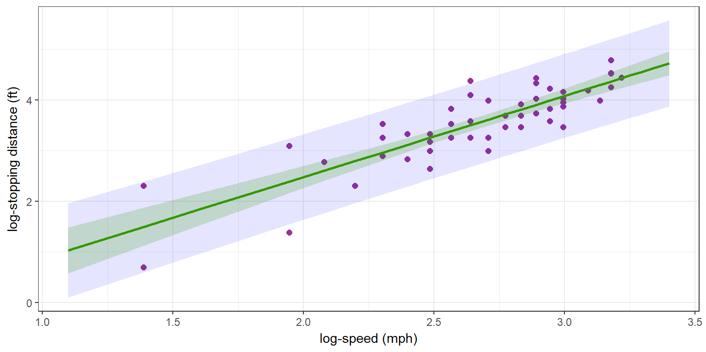
Confidence and prediction intervals
Confidence interval for the regression line (of the model lm(log(dist) ~ log(speed))) and the prediction interval for new observed log-distances.

Slide 82
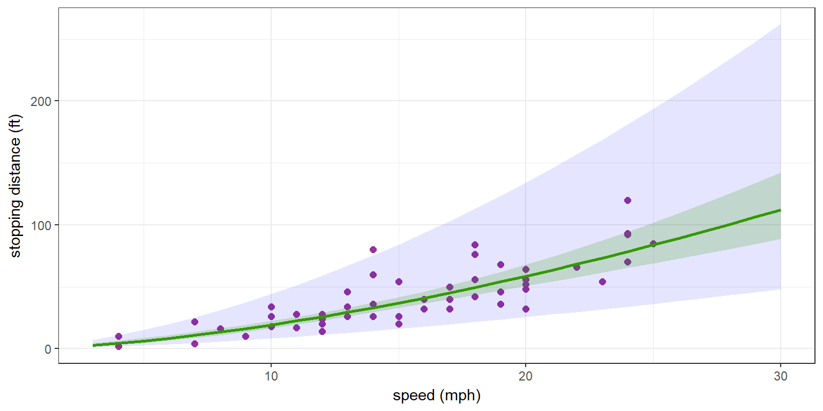
Confidence and prediction intervals
Original scale.

Slide 83
contents
Fitting polynomial models
  Fitting a polynomial of degree 0
  Fitting a polynomial of degree 1
  Numerical results
  Some diagnostic plots
  The predictive performance of the model
  Confidence interval and prediction interval
  Fitting a polynomial of degree 2
  Fitting a polynomial without intercept
  Using orthogonal polynomials
Model comparison
  t-test
  Analysis-of-variance (anova)
  Likelihood ratio test (LRT)
  Information criteria
Data transformation
  log based tranformations
  Diagnostic plots
  Confidence interval and prediction interval
  Model comparison

Slide 84
Model comparison
> logLik(lm1.log)
'log Lik.' -24.76592 (df=3)
> logLik(lm1.log) - sum(log(dist))
'log Lik.' -201.5613 (df=3)
> AIC(lm1.log) - 2*sum(log(1/dist))
[1] 409.1226
> BIC(lm1.log) - 2*sum(log(1/dist))
[1] 414.8587

